Slide 1

Assignment2: Anomaly Detection in Credit Card Transactions
Yihan

Slide 2

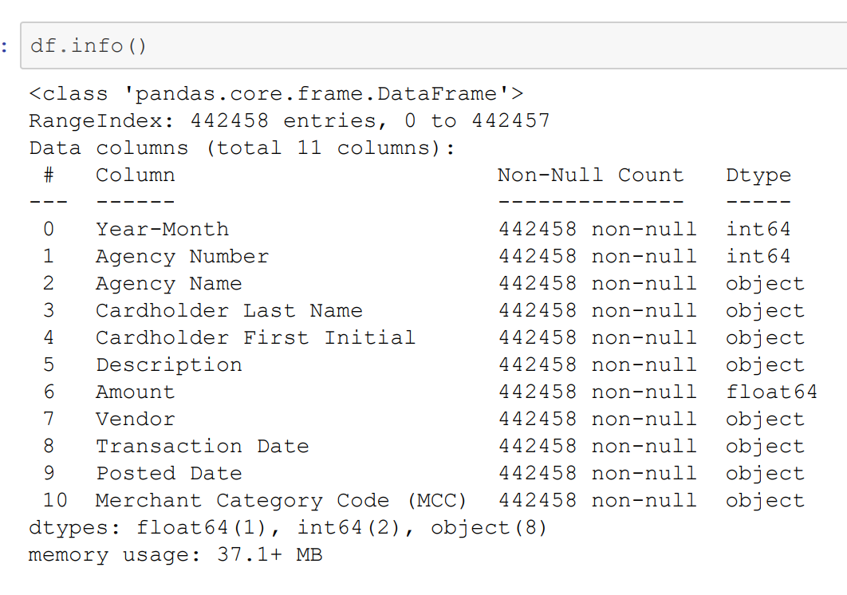
1. Dataset

Slide 3

2: Time-Based Features
Post date-transaction date:
Transaction Day of the Week:
Time Difference between Current and Previous Transaction:
This feature represents the time difference in days between the transaction date and the posted date. It can provide insights into how quickly transactions are processed or if there are any delays in posting.
This feature indicates the day of the week when the transaction occurred. It can help identify unexpected spending patterns on specific days of the week.
This feature measures the time difference in minutes between the current transaction and the previous transaction. It can help identify unusual transaction timing patterns.

Slide 4

3: Amount-Based Features
Average amounts spent per transaction in the past one week
Transaction Amount Deviation from Daily Average
Transaction Amount Relative to Cardholder's Average
Average amounts spent per transaction in the past week help identify transactions deviating from a cardholder's normal spending behavior.
Transaction Amount Deviation from Daily Average measures the difference between transaction amount and daily average, identifying unusual transactions.
Transaction Amount Relative to Cardholder's Average measures the ratio of transaction amount to the cardholder's average, identifying unusual spending patterns.

Slide 5

Frequency of Transactions within Merchant Category
4: Merchant Category and Seasonality Features
This feature counts the number of transactions for the same merchant category code. It can help identify unusual transaction frequency patterns within specific merchant categories.
Transaction Season
This feature indicates the season (Winter, Spring, Summer, Fall) when the transaction occurred. It can help detect anomalies by comparing spending patterns with expected seasonal variations.

Slide 6
5. Conclusion and Next Steps
Through feature engineering, we have created a set of new features that capture various aspects of the transactions and could potentially be useful for detecting anomalies.
Our next step is to feed these features into a machine learning model for anomaly detection.
By monitoring and analyzing these features, we can identify suspicious transactions, mitigate risks, and protect customers.

